Slide 1

Occupational Risk Factors for Ischaemic Heart Disease:
Results from the entire New Zealand population
Dr Amanda Eng
a.j.eng@massey.ac.nz
Dr Marine Corbin
m.corbin@massey.ac.nz
publichealth.massey.ac.nz
These results are not official statistics. They have been created for research purposes from the [Integrated Data Infrastructure (IDI) and/or Longitudinal Business Database (LBD)] which [is/are] carefully managed by Stats NZ. For more information about the [IDI and/or LBD] please visit https://www.stats.govt.nz/integrated-data/.

Slide 2
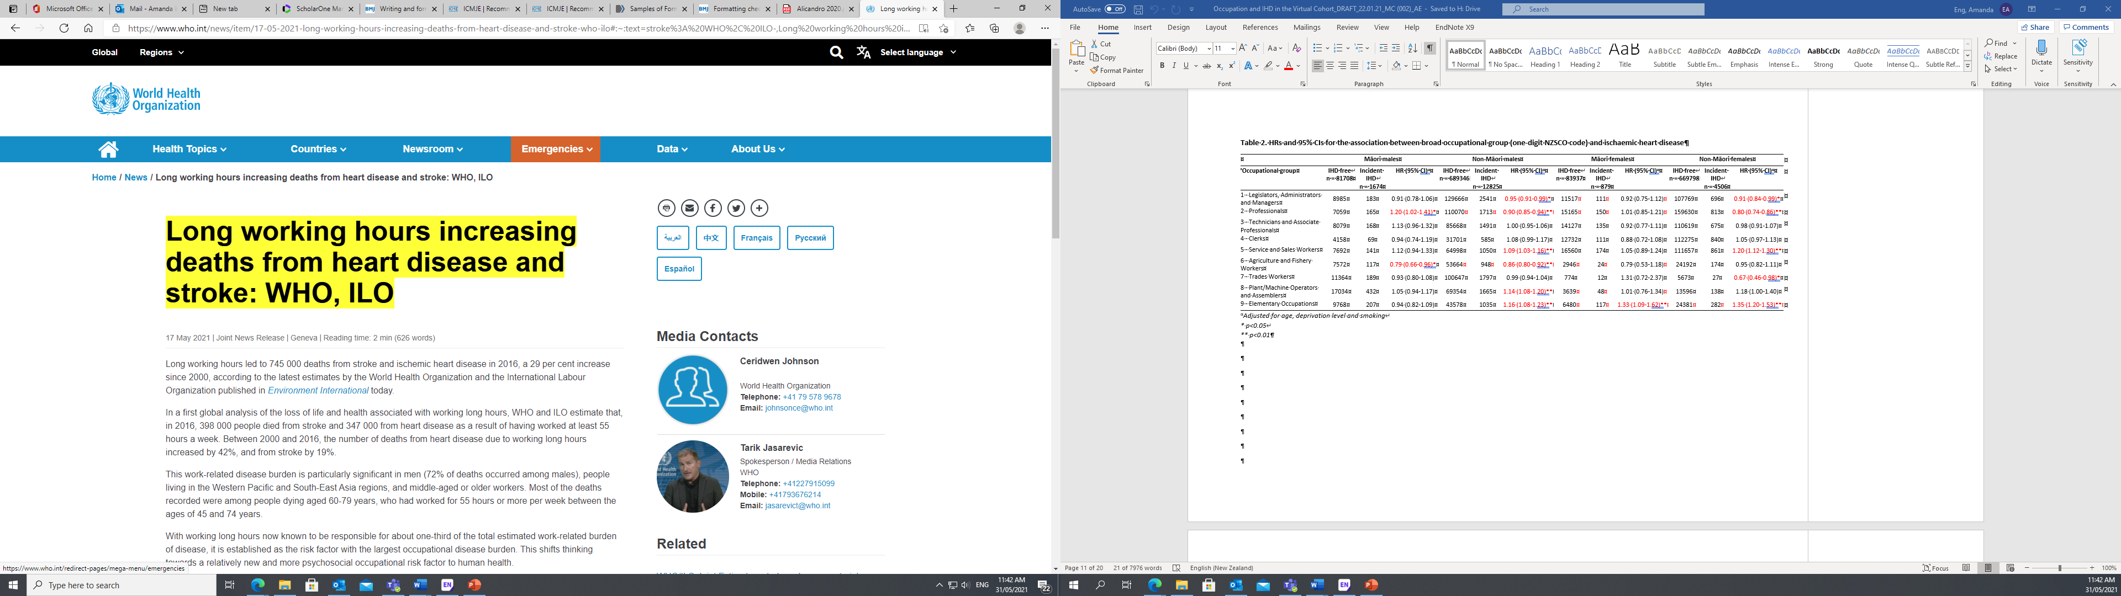
background
CVD is a leading cause of death in most Western countries, including New Zealand
Work-related risk factors are often overlooked despite studies since the 1950s showing associations with CVD
Part I: Are some occupational groups associated with IHD? Do these associations differ by sex and ethnicity?
Part II: Are occupational exposures associated with IHD?
Notes:
Amanda

Slide 3
methods
Study design: prospective cohort study
Study population: all New Zealand residents aged 20-64 years employed at the time of the 2013 census
Exposures:
Occupation (NZSCO 5-digit job code) from the 2013 Census
Working hours (usually worked each week)
Sedentary work
Noise
Night shift
Statistical analysis: Cox proportional hazards regression models stratified by sex and ethnicity (Part I only)
NZ-based Job Exposure Matrices applied to occupation
Notes:
Marine

Slide 4
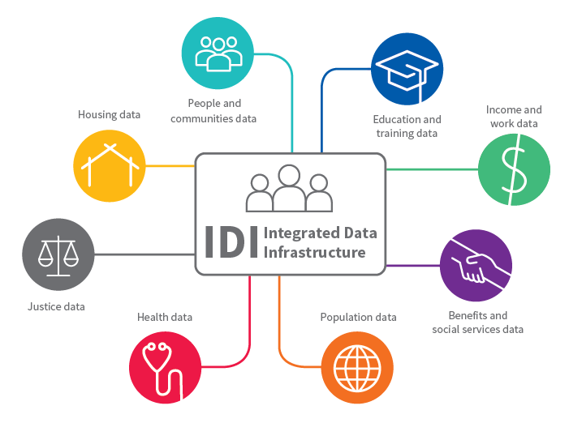
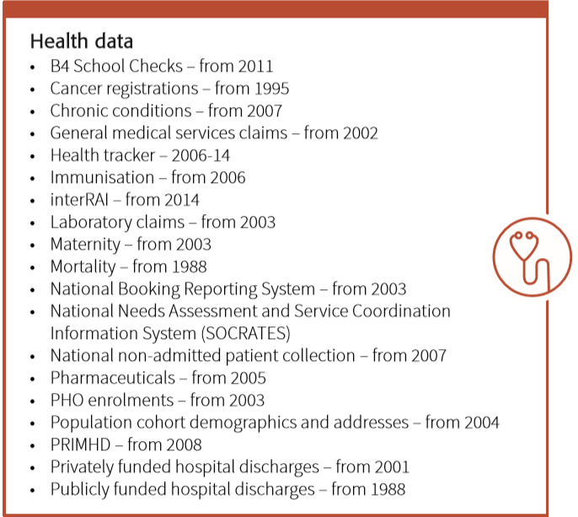
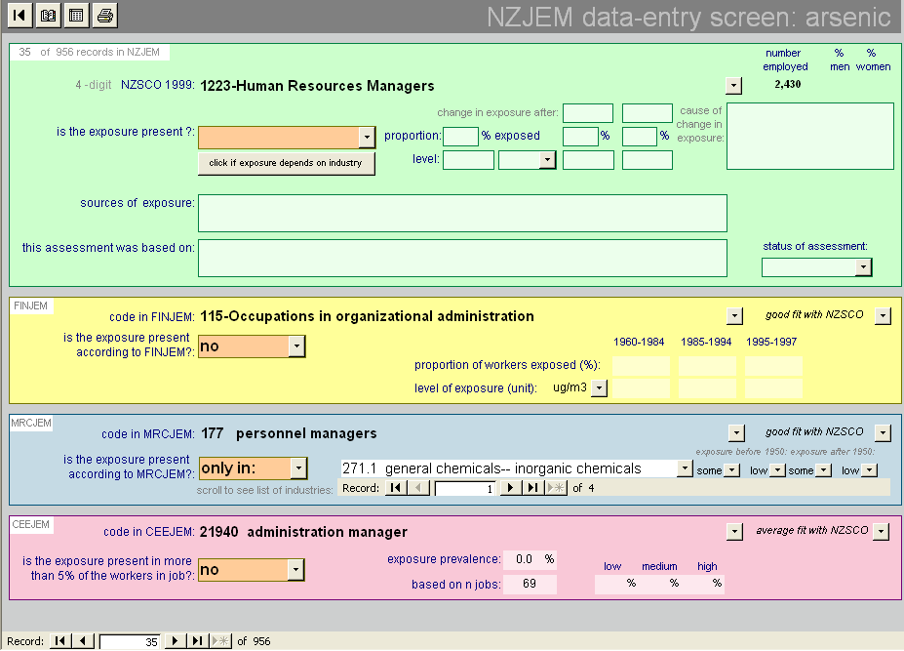
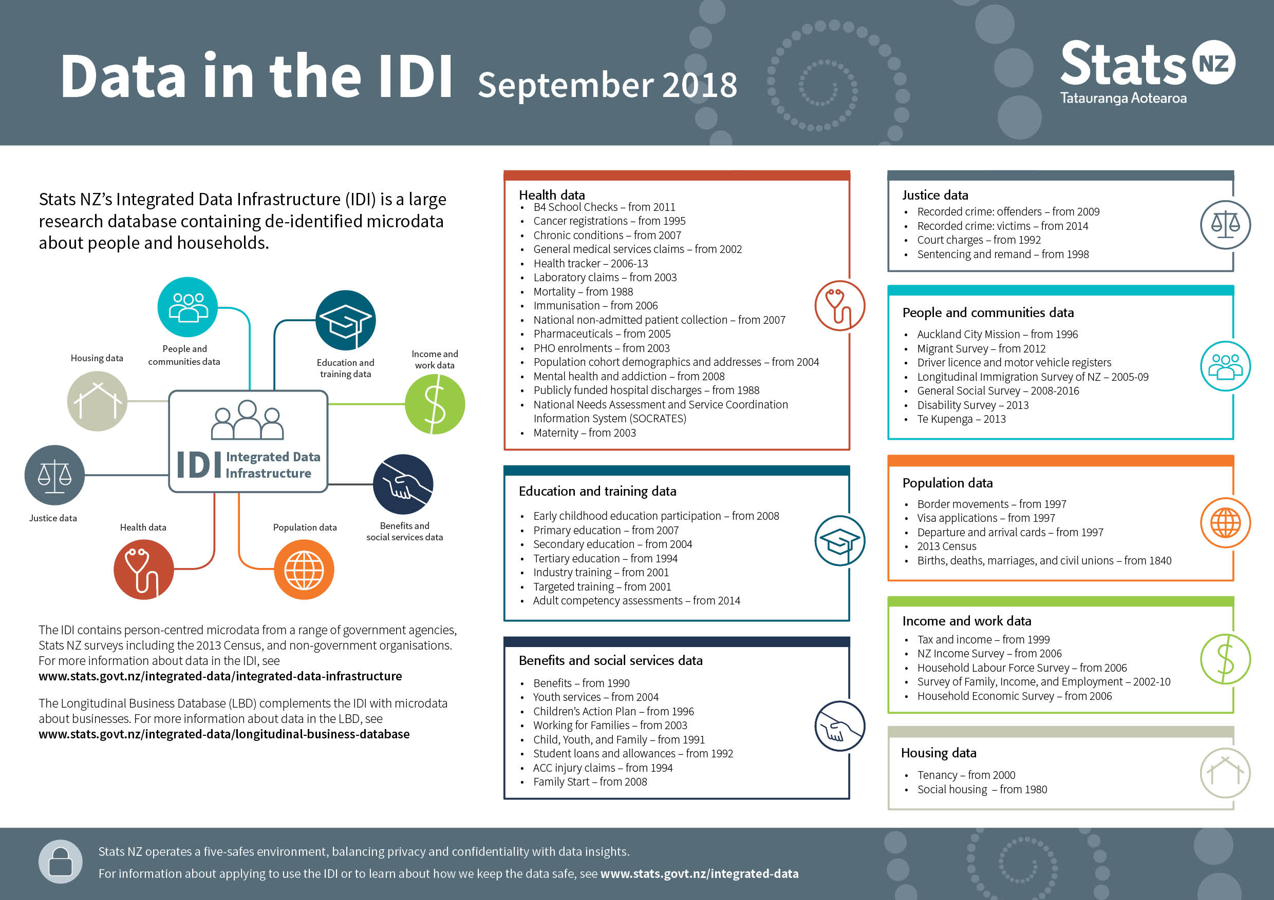
Ad hoc load:
NZ Workforce Survey
Māori NZ Workforce Survey
JEM
Notes:
Marine

Slide 5
Results – PART I
 | Māori males |  |  | Non-Māori males |  |  | Māori females |  |  | Non-Māori females
Occupational group | IHD free | Incident IHD | HR (95% CI) | IHD free | Incident IHD | HR (95% CI) | IHD free | Incident IHD | HR (95% CI) | IHD free | Incident IHD | HR (95% CI)
1 - Legislators, Administrators and Managers | 8985 | 183 | 0.91 (0.78-1.06) | 129666 | 2541 | 0.95 (0.91-0.99)* | 11517 | 111 | 0.92 (0.75-1.12) | 107769 | 696 | 0.91 (0.84-0.99)*
2 - Professionals | 7059 | 165 | 1.20 (1.02-1.41)* | 110070 | 1713 | 0.90 (0.85-0.94)** | 15165 | 150 | 1.01 (0.85-1.21) | 159630 | 813 | 0.80 (0.74-0.86)**
3 - Technicians and Associate Professionals | 8079 | 168 | 1.13 (0.96-1.32) | 85668 | 1491 | 1.00 (0.95-1.06) | 14127 | 135 | 0.92 (0.77-1.11) | 110619 | 675 | 0.98 (0.91-1.07)
4 - Clerks | 4158 | 69 | 0.94 (0.74-1.19) | 31701 | 585 | 1.08 (0.99-1.17) | 12732 | 111 | 0.88 (0.72-1.08) | 112275 | 840 | 1.05 (0.97-1.13)
5 - Service and Sales Workers | 7692 | 141 | 1.12 (0.94-1.33) | 64998 | 1050 | 1.09 (1.03-1.16)** | 16560 | 174 | 1.05 (0.89-1.24) | 111657 | 861 | 1.20 (1.12-1.30)**
6 - Agriculture and Fishery Workers | 7572 | 117 | 0.79 (0.66-0.96)* | 53664 | 948 | 0.86 (0.80-0.92)** | 2946 | 24 | 0.79 (0.53-1.18) | 24192 | 174 | 0.95 (0.82-1.11)
7 - Trades Workers | 11364 | 189 | 0.93 (0.80-1.08) | 100647 | 1797 | 0.99 (0.94-1.04) | 774 | 12 | 1.31 (0.72-2.37) | 5673 | 27 | 0.67 (0.46-0.98)*
8 - Plant/Machine Operators and Assemblers | 17034 | 432 | 1.05 (0.94-1.17) | 69354 | 1665 | 1.14 (1.08-1.20)** | 3639 | 48 | 1.01 (0.76-1.34) | 13596 | 138 | 1.18 (1.00-1.40)
9 - Elementary Occupations | 9768 | 207 | 0.94 (0.82-1.09) | 43578 | 1035 | 1.16 (1.08-1.23)** | 6480 | 117 | 1.33 (1.09-1.62)** | 24381 | 282 | 1.35 (1.20-1.53)**
A priori high risk occupations
Occupational group | Māori males | Non-Māori males | Māori females | Non-Māori females
 | HR(95%CI) | HR(95%CI) | HR(95%CI) | HR(95%CI)
Home helpers | 1.62 (1.08-2.43)* | 1.27 (0.98-1.65) | 1.36 (1.09-1.70)** | 1.43 (1.27-1.61)**
Cleaners | 1.00 (0.72-1.39) | 1.21 (1.07-1.36)** | 1.31 (1.02-1.67)* | 1.47 (1.27-1.70)**
Drivers | 1.04 (0.88-1.23) | 1.20 (1.11-1.30)** | 1.21 (0.67-2.19) | 1.54 (1.04-2.28)*
Labourers | 0.97 (0.81-1.17) | 1.12 (1.03-1.23)* | 1.05 (0.65-1.70) | 1.21 (0.88-1.68)
Prison Wardens | 1.05 (0.63-1.74) | 1.48 (1.15-1.91)** | S | 1.46 (0.66-3.25)
Storekeepers | 0.77 (0.54-1.10) | 1.17 (1.08-1.26)** | 0.80 (0.57-1.11) | 1.02 (0.91-1.15)
Warehouse workers | 0.86 (0.68-1.08) | 1.18 (1.07-1.36)** | 1.47 (1.03-2.10)* | 1.17 (0.91-1.51)
Bakers | S | 0.93 (0.67-1.31) | 2.13 (1.06-4.28)* | 0.86 (0.49-1.51)
Adjusted for age, deprivation level and smoking, * p<0.05, ** p<0.01
Notes:
Marine

Slide 6
Results – PART II
Males
Females
Adjusted for age groups, NZDEP, smoking status, ethnicity and mutually adjusted for sedentary, noise and night shift exposures
Notes:
Amanda

Slide 7
Summary – PART I
Several occupations have been identified at increased risk of IHD: home helpers, cleaners, drivers, warehouse workers, personal and protective service workers.
The study also showed important differences between males and females and Māori and non-Māori.
Notes:
Amanda

Slide 8
Summary – Part II
Night shift work was associated with IHD for both men and women;
A modest association was observed for occupational exposure to high levels of noise for males;
The study does not support sedentary work or long working hours as risk factors for IHD.
Notes:
Amanda

Slide 9

Thank you!
Email: a.j.eng@massey.ac.nz
m.corbin@massey.ac.nz publichealth.massey.ac.nz Amanda Eng and Marine Corbin

Slide 10
Idi health datasets
Outcome | Dataset | Purpose of dataset | Definition
IHD Mortality | Mortality data | Mortality | ICD 10-AM codes for coronary heart disease
IHD Morbidity | National Minimum Dataset (NMDS) | Publicly funded hospital events: diagnosis | ICD 9-CMA & 10-AM codes for coronary heart disease
 | NMDS | Publicly funded hospital events: procedures | ICD 9-CMA & 10-AM codes for: -coronary artery bypass graft; or -coronary angioplasty or stent; or -percutaneous coronary intervention
 | Pharmaceutical data | Pharmaceutical claims | >2 dispensings of anti-anginals less than 12 months apart: -glyceryl trinitrate -isosorbide dinitrate -isosorbide mononitrate -nicorandil -perhexiline maleate

